Slide 1

Atliq Grands Hotels Analysis

Slide 2
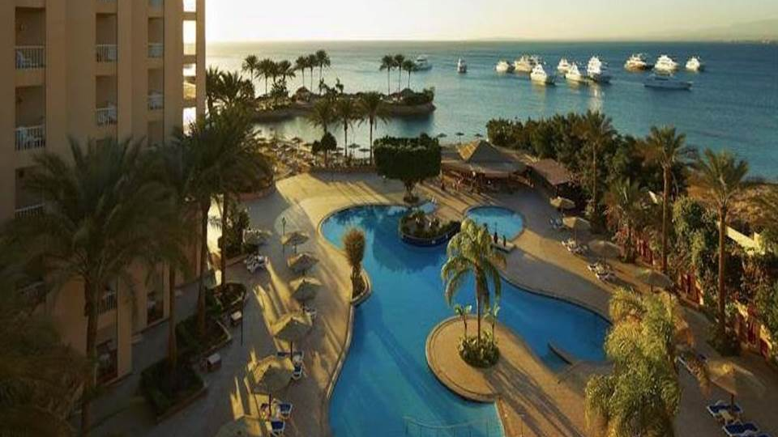
Problem Statement
AtliQ Grands owns multiple five-star hotels across India. They have been in the hospitality industry for the past 20 years. Due to strategic moves from other competitors and ineffective decision-making in management, AtliQ Grands are losing its market share and revenue in the luxury/business hotels category. As a strategic move, the managing director of AtliQ Grands wanted to incorporate “Business and Data Intelligence” to regain their market share and revenue. However, they do not have an in-house data analytics team to provide them with these insights.

Slide 3

Tasks
Create the metrics
Create a dashboard which is self explanatory
Create relevant insights that are not provided in the metric list/mock-up dashboard.

Slide 4

Points Before Starting the project
AtliQ Grands a five stars hotel chain is operating in 4 cities.
It has 7 properties with branches in all these 4 cities.
The rooms in these properties are categorized into 4 categories: Elite, Premium, Presidential, & Standard.
There are 6 main platforms to book the rooms and some other platforms that are not as effective as others.

Slide 5
Dataset
dim_date – This table contains dates, week numbers, and day type (weekend and weekday)
dim_hotels – This table contains data like property id, property name, category, and cities
dim_rooms – This table includes room_id and room class
fact_aggregated_bookings – This is a fact tale that contains property id, check-in date, room category, successful bookings, and capacity

Slide 6
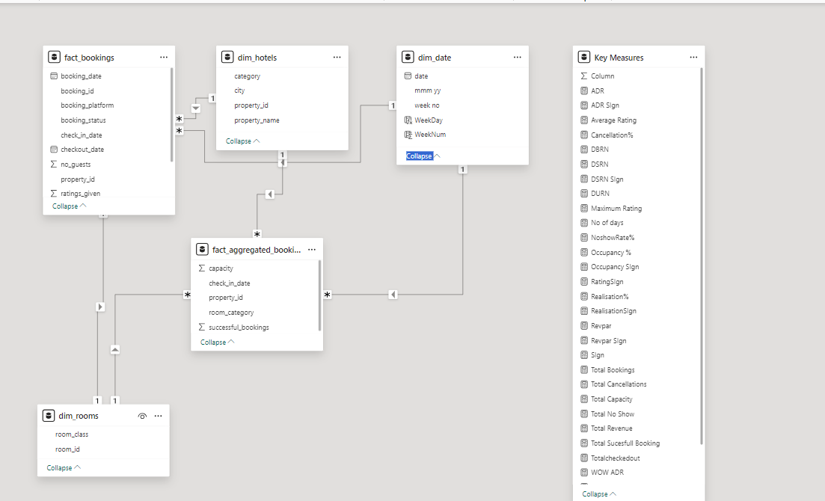
Date Model

Slide 7
Metrics
DSRN – Daily Sellable Room Nights is the metric used for available rooms that can be sold. Example: If there are 100 rooms in a hotel and 20 rooms are not available for any XYZ reason, the DSRN here is 80.
DBRN – Daily Booked Room Nights are the number of nights booked per night.
DURN – Daily Utilized Room Nights are the nights utilized or used by the customers. This can be the checked-in nights.
Cancellation % – As the name suggests, it is the percentage of cancelled bookings.
Avg Rating – Average rating is the average rating given by a customer per booking.
Booking Platforms – Booking platforms are the modes that are used by customers to book rooms. These include AtliQ’s own booking platform and third-party platforms as well.
Week Number – Week number is the number of weeks in a year.
Property Name – Property name is the name of individual hotels.
Property ID – Property ID is the unique ID given to the properties.
WoW – Week on Week is the metric to compare the performance change over the week.
Day Type – Day is the category of days in a week. Weekday and Weekend. In the hospitality sector, the weekend is Friday and Saturday. Most of the customers checkout on Sunday.

Slide 8
Data Cleaning
Derived week number from date column using DAX formula = wn = WEEKNUM(dim_date[date])
1
Derived day type from date column using DAX formula = day_type = var wkd = WEEKDAY(dim_date[date],1) return IF(wkd>5,”Weekend”,”Weekday”)
2
Also, the revenue was not directly provided and it was required to be calculated in the dim_bookings from the column revenue_realized.
3
The revenue columns provided in the data set are:
4
revenue_generated is the column that contains the amount of money generated by hotels from a customer. (Like cancellation money, no show etc)
5
revenue_realized: This column represents the final amount of money that goes to the hotel based on booking status. If the booking status is cancelled, then 40% of the revenue generated is deducted and the remaining is refunded to the customer. If the booking status is Checked Out/No Show, then the full revenue generated will go to hotels.
6
Revenue = SUM(fact_bookings[revenue_realized])
7

Slide 9
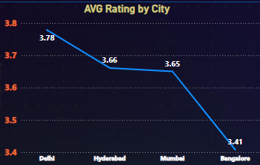
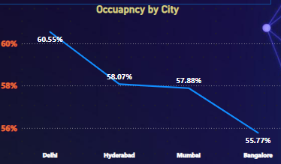
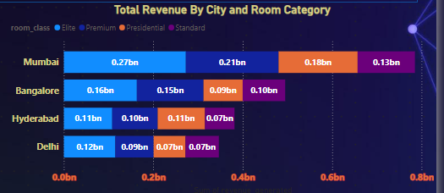
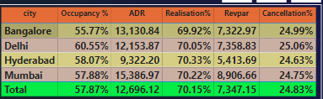
City Insights
Mumbai is the Highest Revenue Generating City , generating 0.66 billion of revenue and also has the highest Revpar (8906) , Highest ADR (15386) and also has the Realization of 70.22 %
Delhi has the Highest Occupancy of 60.55% and also got the highest avg rating of 3.78
Delhi has slightly highest cancellation rate compared to others
Hyderabad has the lowest ADR and Revpar

Slide 10
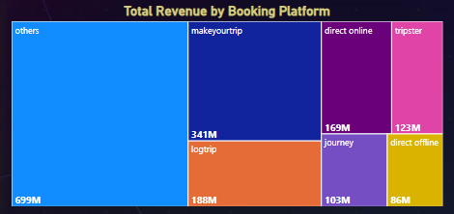
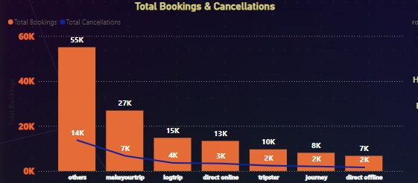
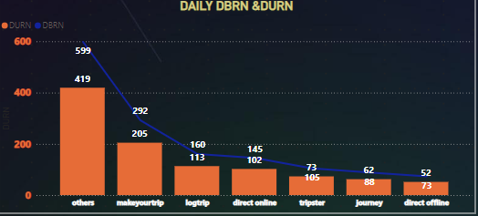
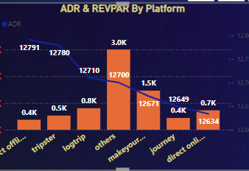
Booking Platform Analysis
We got the maximum booking(55k) , cancellation(14K) and revenue(699M) from other platforms and our DBRN , DURN and Revpar is also the highest from Other platforms
Maximum ADR is from Direct Offline Mode of booking and lowest from Direct Online Booking
Make your trip and logtrip are the platforms which generate the good revenue after other platforms and ADR is also good from these platforms

Slide 11
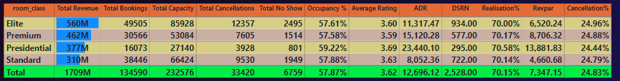
Room Class Analysis
Room Class Elite has generated the highest revenue and also has the highest no shows with the average rating of 3.6 , highest DSRN
Presidential Room Class has the lowest no shows , Highest ADR & Revpar

Slide 12
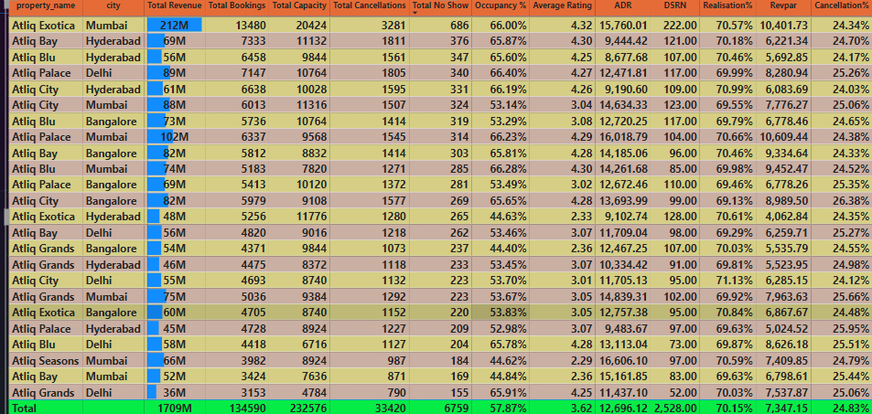
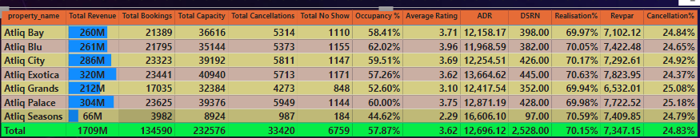
Properties Analysis
Atliq Exotica has generated the highest revenue and we need to focus on Atliq Season hotel it has the highest ADR and lowest Avg rating , Lowest DSRN
Atliq Blu had the highest Average Rating and was 72.54% higher than Atliq Seasons, which had the lowest Average Rating at 2.29.
13.59% of revenue realized from Mumbai.
Revapar is almost same in all the properties
We also need to focus on Atliq Grands has the second lowest rating & Revenue & Occupany

Slide 13

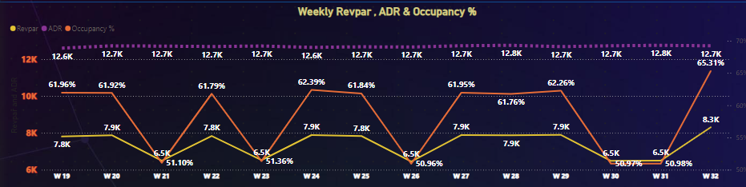
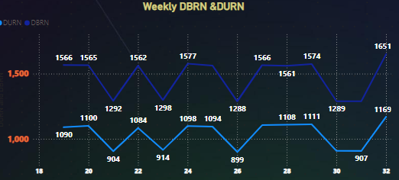
Weekly Analysis

Slide 14
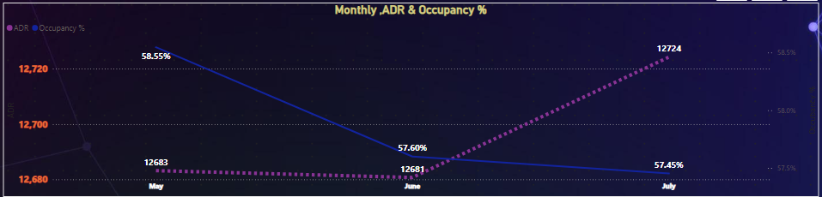
Monthly Analysis
June month has seen the dip in revenue , even the ADR and Occupancy is low
July month has shown the significant improvement in ADR and Occupancy and revenue is also back to normal business

